Slide 1
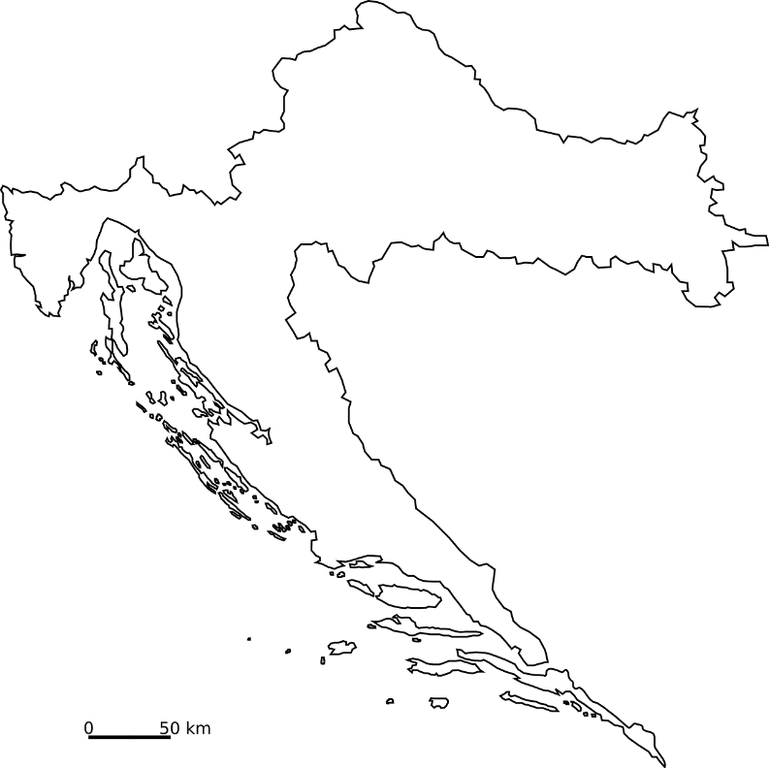
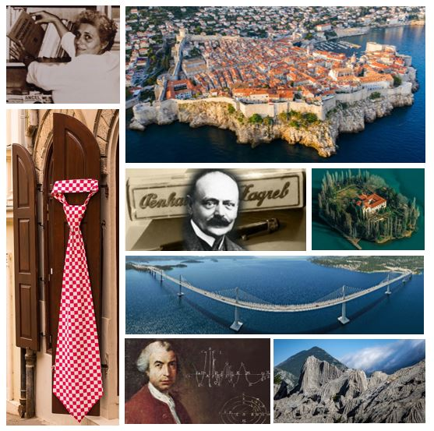
EUROPEAN AND NATIONAL RI LANDSCAPE
Croatia
THE MINISTRY OF SCIENCE, EDUCATION AND YOUTH
Jelena Ilić-Dreven

Slide 2
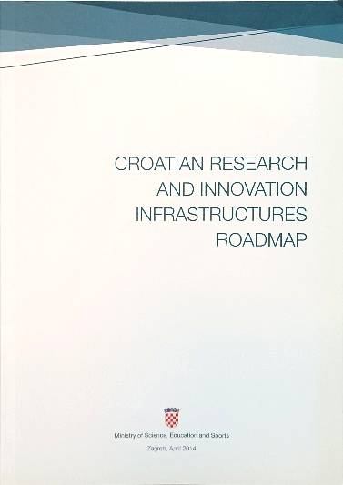
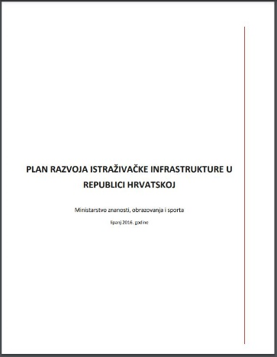
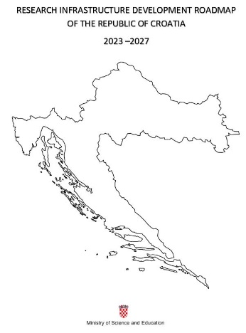
A bit of history
The youngest EU member state.
Since 2012 → designated national expert body for RI.
Support the realization of the goals of key strategic documents in the field of RDI.
2014
2016
2023

Slide 3
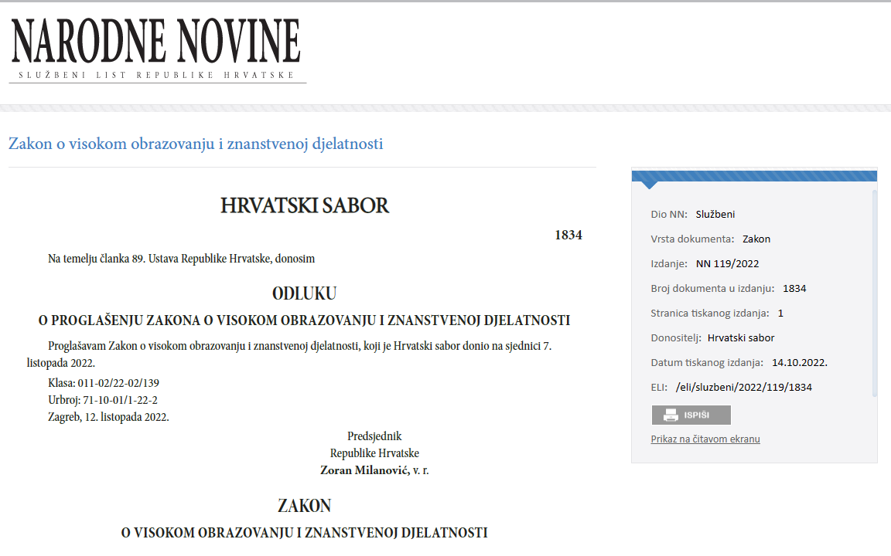
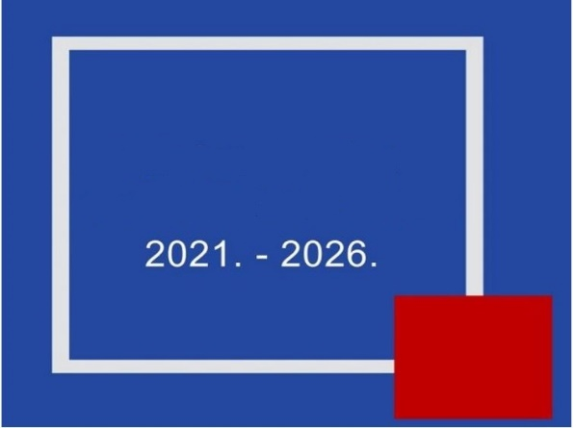
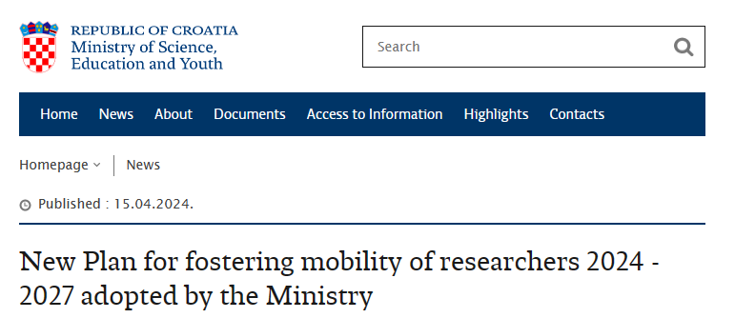
Policy reforms quick overview
National Recovery and Resilience Plan
S3
3

Slide 4
Strategic Committee for Research Infrastructure
Since 2012.
Prominent and independent experts in different fields of science.
Counsel to the MSEY on different issues related to RI.
Their main roles:
Assistance with the national Roadmap.
Recommendations and guidelines for the development of national RI.
Evaluating requests for joining international RI.
Counselling of Croatian ESFRI delegates.

Slide 5
In June Croatia published its RI Roadmap 2023 – 2027
Provides an overview of:
The existing research infrastructure in Croatia.
ERIC and other infrastructure we participate in.
International research organizations we participate in.
It provides monitoring criteria & basic criteria for the
selection and financing of future RIs.
Public consultations were open 30 days.
National Recovery and Resilience Plan
5

Slide 6
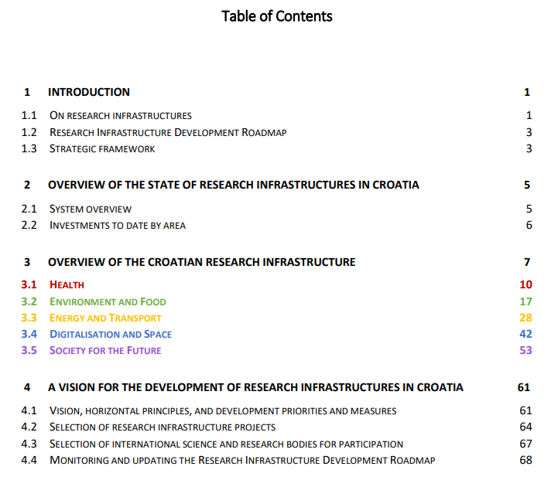

Slide 7
The areas of focus are:
Health
Environment and Food
Energy and Traffic
Digitalisation and Space
Society for future
19 international RI and organizations.
We singled out 21 national research infrastructures.
Through the use of national and international RI, Croatia will excel in internationally competitive research and will strengthen international cooperation and the visibility of Croatian science, economy, and society as a whole.
7

Slide 8
PRIORITIES
1) Long-term sustainability & contribute to the national R&I system
NO. OF POTENTIAL USERS
CONTRIBUTION TO
SGDs
INDENTIFIED GAPS
COST/
BENEFIT
BUSINESS SECTOR & INDUSTRY
ECOLOGICAL FOOTPRINT
EXCELLENCE
VISIBILITY

Slide 9
PRIORITIES
2) open access and cooperation with other stakeholders
FAIR
PRINCIPLES
DMP
CATALOGUE OF SERVICES
LIST OF EQUIPMENT
WEBSITE
HR + EN
NETWORKING

Slide 10
Horizontal principles:
Promote the use of FAIR principles.
Provide open and transparent access to the infrastructure.
Strengthen international cooperation and visibility of Croatian scientists.
Foster excellence in science.
Consolidate the national research community.
Sustainable development, circular economy and bioeconomy.
Equity and equal opportunities.
National Recovery and Resilience Plan
10

Slide 11
11

Slide 13
13

Slide 14
The process for joining international RI
The interested public institution needs to express its interest to join international RI to the MSEY.
The Ministry consults its advisory body - The Strategic Committee for RI.
The Ministry makes the final decision taking into account opinion of The Strategic Committee, available funding and the overall development of the science and innovation system in Croatia.
14

Slide 15
The national roadmap process for RI
Selection criteria
Cost-benefit analysis that takes into account:
Number of potential users (number of faculties & scientific institutes in the field, scientists, interest of foreign partners etc.).
Identified gaps in certain areas at the national level.
Relevance of the infrastructure in relation to national development goals and priorities.
Uniqueness at the national level.
15

Slide 16
Monitoring and updating
Regular and effective collection of all relevant data.
Monitoring the achievement of national research infrastructures.
Increasing the visibility.
Timely identification of problems and introduction of corrective measures.
Informed strategic planning and evidence-based public policy making.
Evaluation of the efficiency of public investments and planning of future ones.

Slide 17
New RI since
17

Slide 18
Croatia participates in 8 ERICs
EPOS (The European Plate Observing System)
EATRIS (European Infrastructure for Translational Medicine)
CERIC (Central European Research Infrastructure Consortium)
CLARIN (Common Language Resources and Technology Infrastructure (for humanities and social sciences)
SHARE (Survey of Health, Ageing and Retirement in Europe)
DARIAH (Digital Research Infrastructure for the Arts and Humanities)
ESS (European Social Survey)
CESSDA (Consortium of European Social Science)

Slide 19
A part of 4 ESFRI projects or landmarks:
IFMIF DONES (International Fusion Materials Irradiation Facility – Demo Oriented NEutron Source)
CTA (Cherenkov Telescope Array)
EHRI (European Holocaust Research Infrastructure)
GGP (Generations and gender Programme)

Slide 20
Member of 9 international organizations such as:
ESA (European Space Agency)
CERN (European Organisation for Nuclear Research)
EOSC (European Open Science Cloud)
EuroHPC (European High Performance Computing Joint Undertaking)
EMBO (European Molecular Biology Organization)
CIESM (Mediterranean Science Commission)
ICGEB (International Centre for Genetic Engineering and Biotechnology)
ICC (International Association for Cereal Science and Technology)
IIR (International Institute of Refrigeration)

Slide 21
Short overview of FP participation
In Horizon 2020 it had the highest success rate of 52%
For RI in HE we have the highest success rate of 67%
Mostly in INDFRADEV and 64% RIA
With the amount of 1.83M EUR

Slide 22
Thank you!
Contact:
Jelena.IlicDreven@mzo.hr

